Slide 1
CND212: Digital Testing and Verification

Slide 2
Digital IC Verification

Slide 3
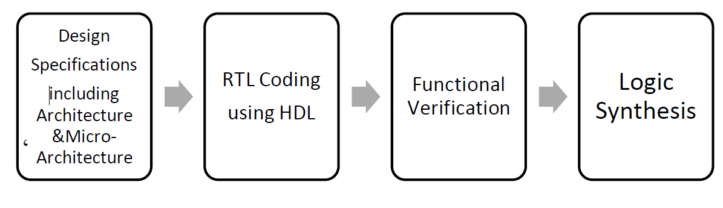
Introduction
Normal VLSI/Chip design flow

Slide 4
The Verification Process
The process of checking that a given design correctly implements the specification and the required functionality.
A verification engineer accomplishes this by:
Reading the hardware specification
Creating a verification plan
Building tests that show the RTL code correctly implements the features
Verification also includes error injection and handling.
How does the design handle errors?
How should it recover from them?
Verification consumes around 80% of the total product development time.

Slide 5
What is Verified?

Slide 6
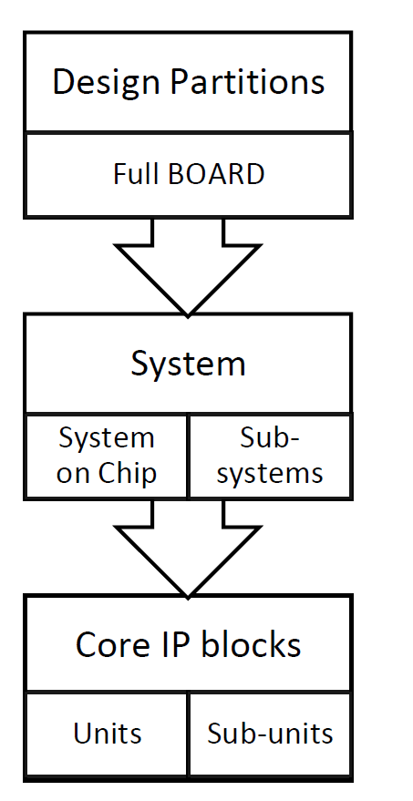
Verification Levels
Basic verification: (at Unit/Sub-unit level)
Functional verification (at IP blocks level)
System level verification: (at the Systems level)
Connectivity: (at Board level)

Slide 7
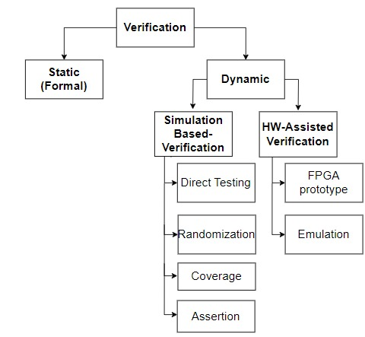
Verification Methods

Slide 8
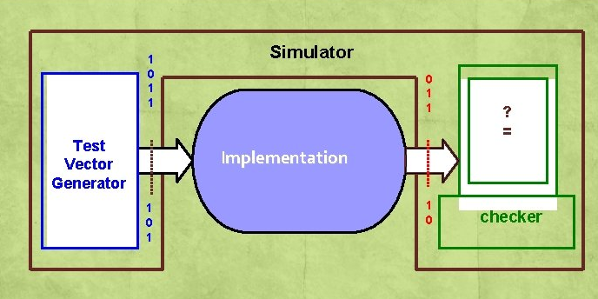
Verification Methods
Simulation Based Verification
Vivolo, L.. Transaction-based Verification And Emulation Combine For Multi-megahertz Verification Performance. [online] Electronicdesign.com. Available at: <https://www.electronicdesign.com/technologies/eda/article/21796417/transactionbased-verification-and-emulation-combine-for-multimegahertz-verification-performance>.

Slide 9
Verification Methods
Formal Verification
It is a method by which we prove or disprove a design implementation against a formal specification or property by using a mathematical model.
An algorithm is used to explore all possible input values over time and to exercise all possible states in a design.
It works well for small designs where the number of inputs, outputs, and states is small.

Slide 10
Verification Methods
Assertion-based Verification
An assertion is a statement about a design’s intended behavior, which must be verified.
It is a way of capturing a design’s intention or part of the design’s specification in the form of a property; this property can be used along with dynamic simulation and with formal verification to ensure whether this specification is met.
Assertions Benefits:
Improves observability and debugging ability.
Improves integration through correct usage checking.
Improves verification efficiency.

Slide 11
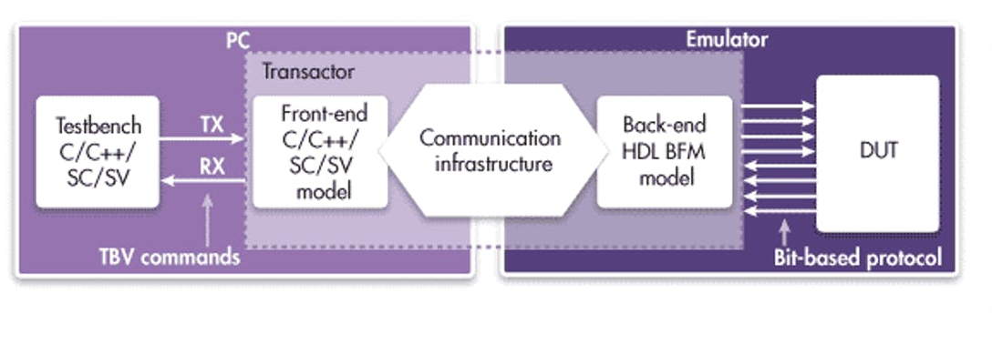
Verification Methods
Emulation Based Verification
Vivolo, L., 2021. Transaction-based Verification And Emulation Combine For Multi-megahertz Verification Performance. [online] Electronicdesign.com. Available at: https://www.electronicdesign.com/technologies/eda/article/21796417/transactionbased-verification-and-emulation-combine-for-multimegahertz-verification-performance.

Slide 12
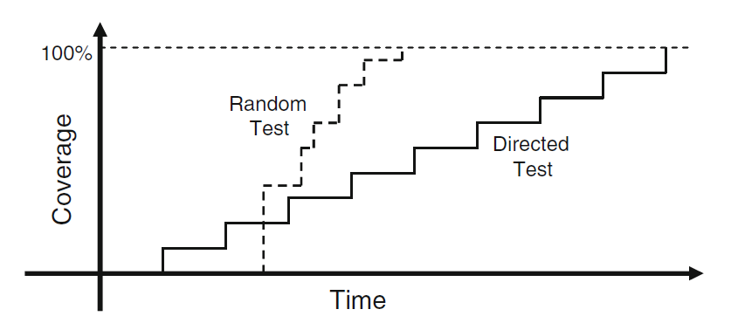
Verification Testbench
A Testbench is implemented to check the functional correctness of the DUT. This is achieved by doing the following:
Generate stimulus
Apply stimulus to the DUT
Capture the response
Check for correctness
Measure progress against the overall verification goals
There are different approaches for testing:
Directed Testing
Pure Random Testing
Constrained random stimulus
constrained

Slide 13
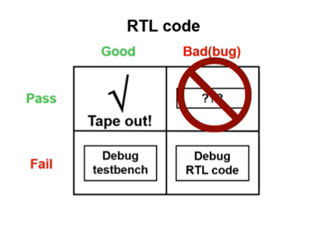
Well Designed Verification Environment
Test Environment must:
Be structured for debug
Avoid false positives
Tests must:
Achieve Functional Coverage
Prevent untested regions
Reach Corner Cases
Anticipated Cases
Error Injection
Environment Error
DUT Error
Unanticipated Cases
Random tests
Be Robust, Reusable, Scalable
Testbench

Slide 14
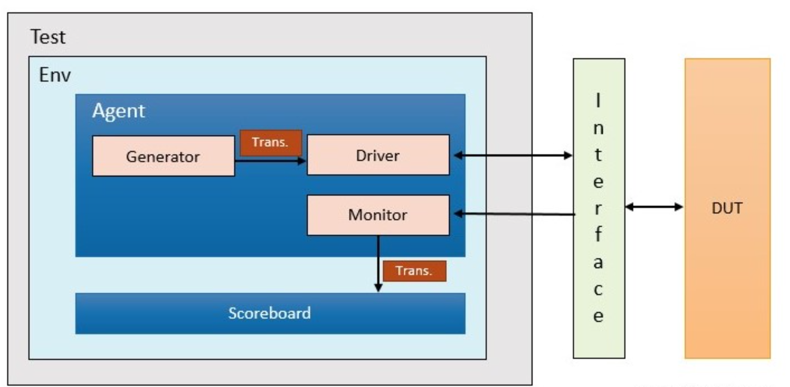
Verification Testbench
Transaction
Class that holds a structure used to communicate with DUT.
Then converted to pin-level data to be driven to the DUT or monitored.
Generator
Creates or generates randomized transactions or stimuli and passes them to the driver.
Driver
Interacts with DUT directly.
Receives randomized transactions from the generator and drives them to the DUT as a pin-level activity.
Monitor
Observe pin-level activity on the connected interface at the input and output of the design.
Then, convert the pin-level activity into a transaction packet and send it to the scoreboard for checking purposes.
Top

Slide 15
Verification Testbench
Test
The test is at the top of the hierarchy, initiating the construction of the environment components and the connection between them.
Responsible for the testbench configuration and stimulus generation process.
Testbench top
The top-level component that includes interface and DUT instances.
The design is connected to the testbench in the Top model.
Efficient Verification Testbench
Layered.
Reusable.
Scalable.
Easier to maintain.
Top

Slide 16
SystemVerilog Basics

Slide 17
SV Lexical Conventions
Same as Verilog
Case sensitive identifiers (names)
Any sequence of letters, digits, $, and _
First character cannot be a digit or $
White spaces are ignored except within strings
Comments:
Single line // ….
Multiple lines /* …. */

Slide 18
SV Number Format
Number format now supports sign/unsigned declaration
<size>’[s|S]b (binary)
<size>’[s|S]d (decimal)
<size>’[s|S]h (hexadecimal)
<size>’[s|S]o (octal)
Can be padded with ‘_’ for readability
Sign Conversion
signed’(myvar);
unsigned’(myvar);
logic [7:0] my value; //defaults to unsigned
my_value = 8’b1; // 8’b0000_0001 (unsigned)
my_value = 8’sb1; // 8’b0000_0001 (signed)
//unsized padding of bits
my_value = ‘1; //8’b1111_1111
Notes:
Without the [s|S] -> unsigned
With the [s|S] -> signed

Slide 19
SV Data Types
SystemVerilog introduces new data types with the following benefits.
Two-state: better performance, reduced memory usage
Queues, dynamic and associative arrays and automatic storage: reduced memory usage, built-in support for searching and sorting
Unions and packed structures: allows multiple views of the same data
Classes and structures: support for abstract data structures
Strings: built-in string support
Enumerated types: code is easier to write and understand

Slide 20
SV Data Types
Data type is a storage format having a specific range or type.
Two states data type, each bit is
Logic 0
Logic 1
Four states data type, each bit is
Logic 0
Logic 1
Logic X; unknown (either 0/1)
Logic Z; high impedance (floating)
Notes:
Example when to use 2-state and 4-state

Slide 21
SV Data Types: Four State (0|1|X|Z)
reg | logic [msb:lsb] variable_name [=initial_value];
4-state data type: logic | reg
reg and logic are synonyms
SystemVerilog improves the classic reg to have the following features:
It can be driven by continuous assignments, gates, and modules, in addition to being a variable.
It is given the new name logic so that it does not look like a register declaration.
Initialized to ‘x if initial value is not specified
Defaults to unsigned

Slide 22
SV Data Types: Four State (0|1|X|Z)
Sized 4-state variable: integer, time
integer variable_name [=initial_value];
32-bit signed
time variable_name [=initial_value];
64-bit signed
integer a = - b;
time current_time;
b = -a;
current_time = $time;
If (current_time >= 100ms) ….. ;

Slide 23
SV Data Types: Two State (0|1)
bit [msb:lsb] variable_name [=initial_value];
Better compiler optimizations for better performance
Variable initialized to ‘0 if initial_value is not specified
Assigned 0 for x or z value assignments
Sized as specified
Defaults to unsigned

Slide 24
SV Data Types: Two State (0|1)
2-state-type variable_name [=initial_value];
Type | Description | Example
bit | user-determined range | bit [3:0] a_var;
byte | 8 bits, signed | byte a, b;
shortint | 16 bits, signed | shortint c, d;
int | 32 bits, signed | int i,j;
longint | 64 bits, signed | longint lword;

Slide 25
SV Data Types: Two State (0|1)
2-state-type variable_name [=initial_value];
Type | Description | Example
shortreal | like float in C | shortreal f;
real | like double in C | real g;
realtime | identical to real | realtime now;

Slide 26
SV Data Types: String Data Type
string variable_name [=initial_value];
Defaults to empty String “”
Can be created with $sformatf() system function
Built-in operators and methods:
==, !=, compare () and icompare()
Itoa (), atoi, atohex () , toupper (), tolower (), etc.
len (), getc (), putc (), substr ()

Slide 27
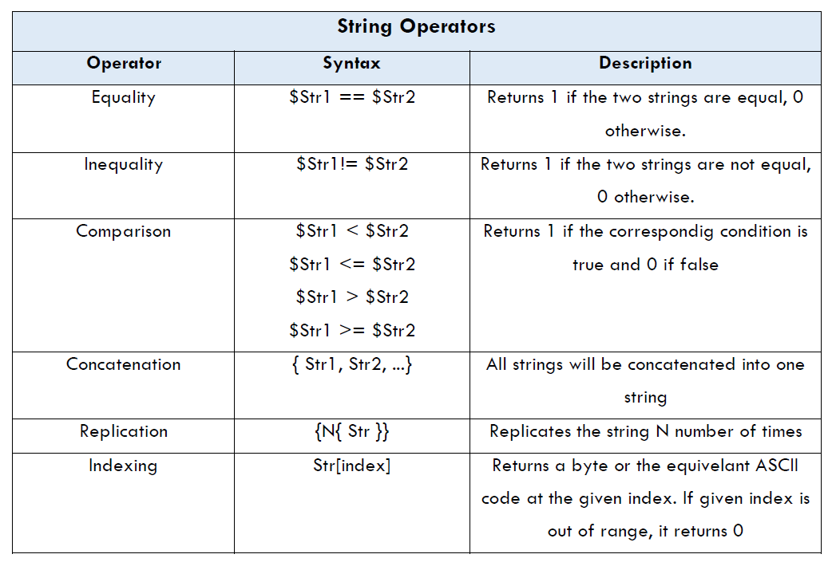
SV Data Types: String Data Type
string variable_name [=initial_value];

Slide 28
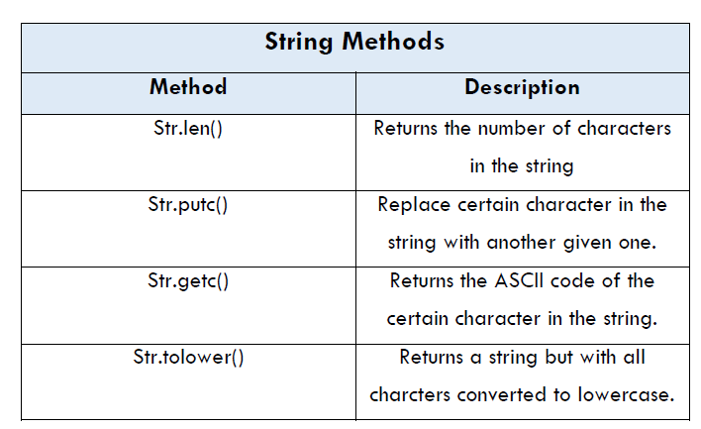
SV Data Types: String Data Type
string variable_name [=initial_value];

Slide 29
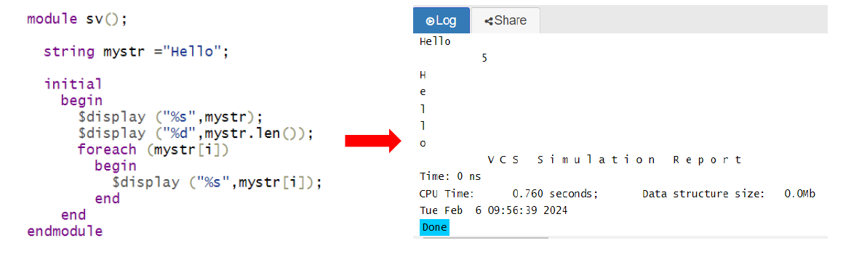
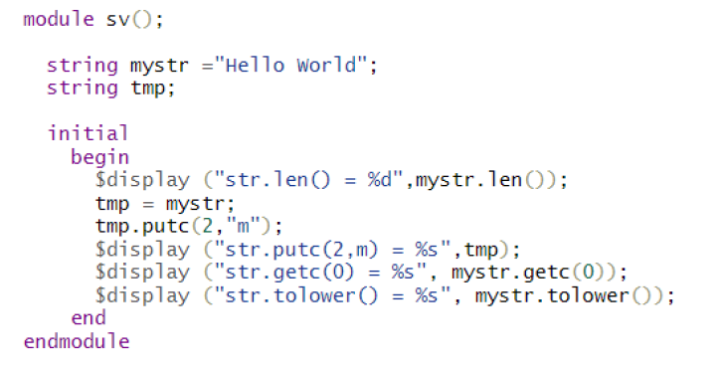
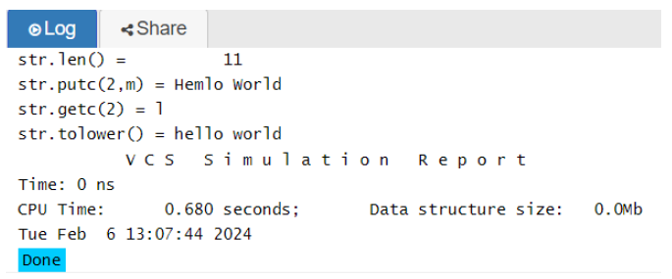
SV Data Types: String Data Type

Slide 30
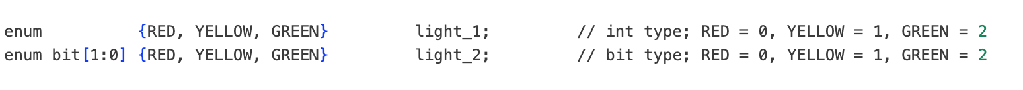
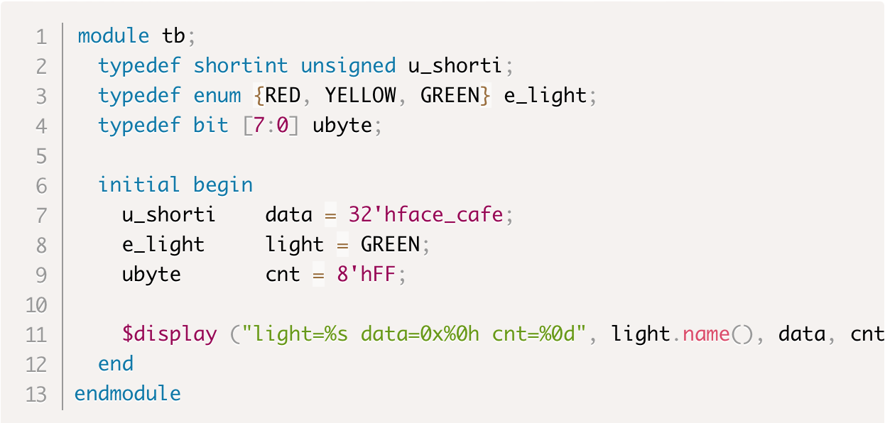
SV Data Types: Enumerated Data Type
Define enum variables
enumtype variable_name [=initial_value];
Date type defaults to int
Variable initialized to ‘0 if initial_value is not
specified (x for a 4-state data-type)
enum can be displayed as ASCII or value
Define enumerated type
typedef enum [data_type] {named constants} enumtype;

Slide 31
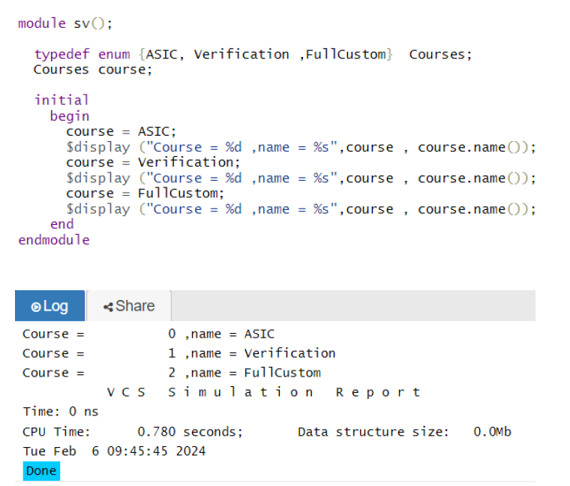
SV Data Types: Enumerated Data Type

Slide 32
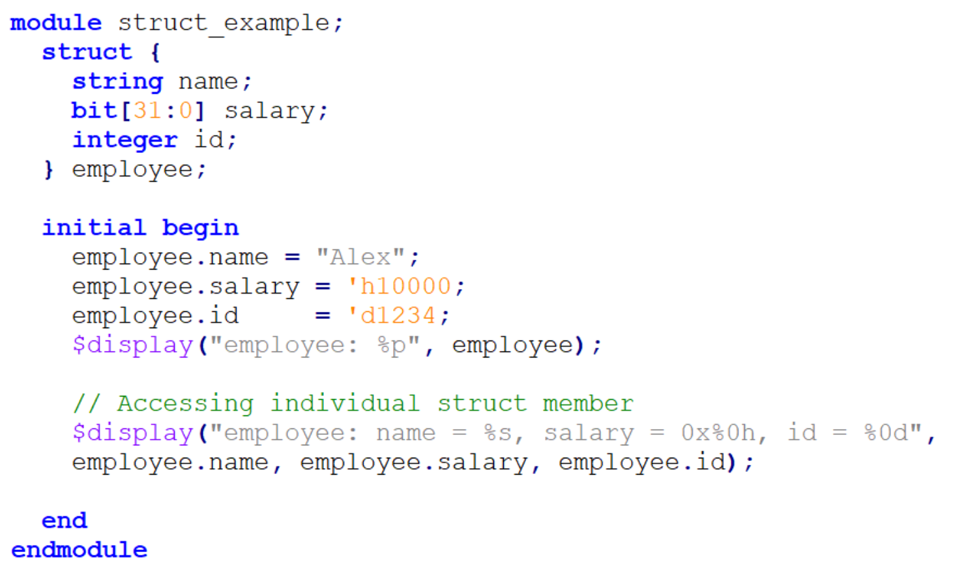
struct – Data Structure
Contains elements of different data types.
Struct is unpacked by default.
The new data type can be used throughout the code, avoiding editing in multiple places if required.
We can create a user-defined data type of a struct using typedef for multiple struct variables with the same contents

Slide 33
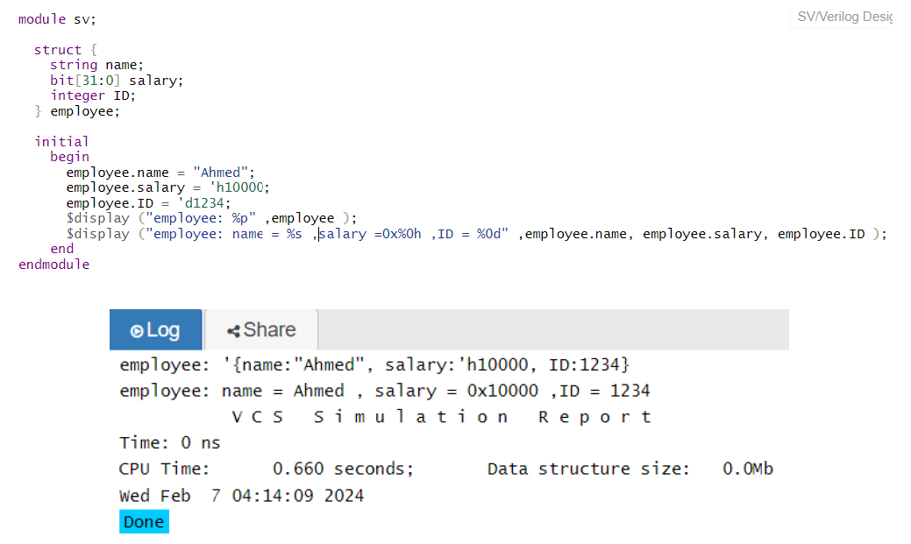
struct – Data Structure

Slide 34
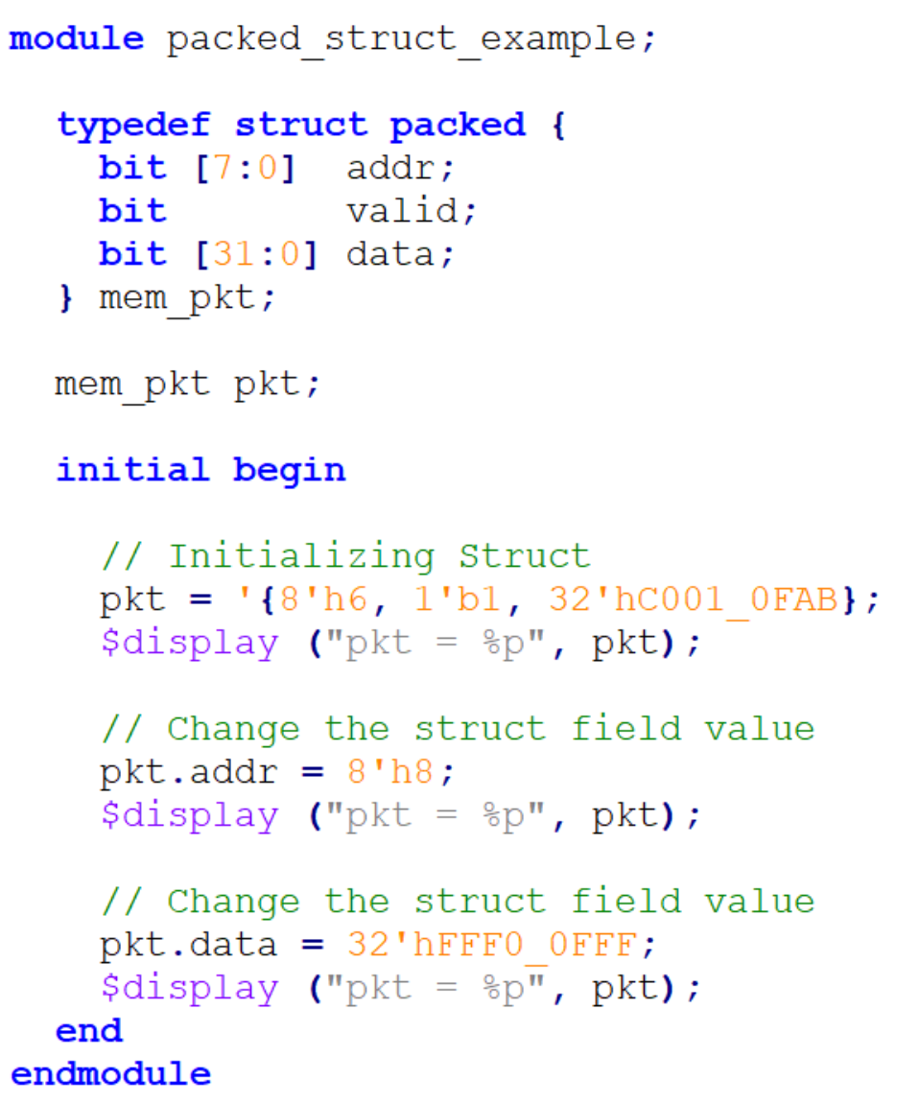
struct – Data Structure
Packed structs
struct defined with Packed keyword.
Contains only packed data types.
Variables are packed together in memory without gabs.

Slide 35
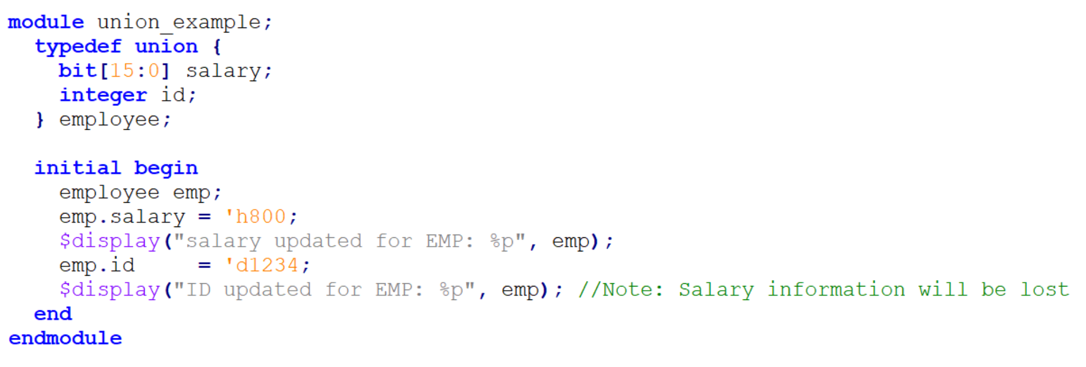
union – Data Union
Like struct, contain different data types members,
But they share the same memory location.
Therefore,
Memory efficient data structure.
Restricts using one member at a time.

Slide 36
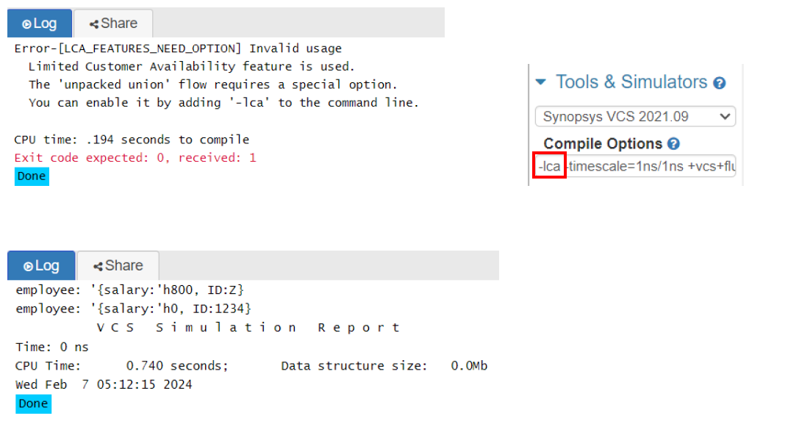
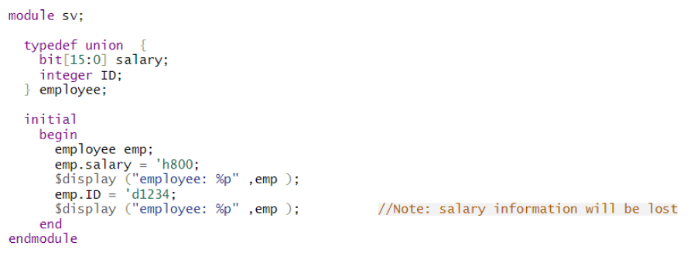
union – Data Union

Slide 37
Lab 1: ( ~ 60 min)

Slide 38
Lab 1: design specs
In this lab, a model of communication protocol packet construction can be designed using the SystemVerilog data types. The model constructs and displays from 10 to 20 packets of random data.
Each packet contains the following:
Packet ID: 0,1,2…
Packet sent time.
Packet data that is 32-bit width.
Packet Type: Data, Command, Control.
The packets are constructed and displayed such that:
The First packet type is Control.
The second packet type is Command.
The rest of the packets type is data

